Slide 1

RESTORATION OF WETLAND COMPLEXES AS LIFE-SUPPORTING SYSTEMS IN THE DANUBE BASIN – RESTORE4LIFE
Dr. Mihai Adamescu - RCSES University of Bucharest
www.restore4life.eu
Project: 101112736— HORIZON-MISS-2022-OCEAN-01

Slide 2
Lessons from Restore4Life:
Restoring Wetlands for a Sustainable Future
NO lessons! – this is a continuous learning process involving a plethora of stakeholders; multiple conflicting interests (from conservationist, to agricultural interests to industry) at different scales;
Local community – should be the driving factor! We should understand the long term and short-term interest for the community for our children, for ourselves;
We need to be really passionate to change things! Science alone is not going to change things!
Many things should come together to really have an impact: stakeholders (people); policy; science; business (money and interest); legislation (and a lot of things that we cannot even describe.. Local interest, behavior, …..the world that seems that is close to end!)…..

Slide 3
Presentation Overview
20-minute journey through wetland restoration
Why Freshwater Restoration?
Restore4Life Project
01
02
The urgency and EU policy context
Mission, scope, and partnership
Implementation Sites
Restoration Approaches
03
04
Four countries, four ecosystems
Passive and active measures
Monitoring & Tools
Key Takeaways
05
06
EO, citizen science, ML applications
Lessons learned and next steps

Slide 4
Why is it Beneficial to Restore Ecosystems?
Restoring landscapes and marine ecosystems is urgent not only because they are home to countless plants and animals, but also because the ecosystem services they provide are worth an estimated 120 trillion euro every year to the global economy and wetland (like all ecosystems are of importance to life!- they are life!) …but despite this (we better understand money) so here it is :
1. Healthy ecosystems and landscapes support industries like farming, fishing, forestry, and tourism, which employ worldwide 1.2 billion people.
2. Globally, each Euro invested in restoring degraded landscapes can bring 5-30 euros in economic returns.
RESTORE4LIFE
Bucharest 12-15 September 2023

Slide 5
Why Freshwater Restoration?
80%
25%
30%
"Wetlands are vital for climate, biodiversity, and human well-being"
of EU wetlands
lost since 1900
freshwater species
at extinction risk
EU target for
restored ecosystems
EU Policy Framework for Restoration!
• EU Biodiversity Strategy 2030: Restore degraded ecosystems
• EU Nature Restoration Law: Binding restoration targets
• Mission Ocean & Waters: Restore freshwater ecosystems by 2030
• Green Deal: Climate neutrality requires healthy wetlands
— EU Mission Charter

Slide 6
Are we going to reach the targets?
NO!!!! We are moving to slow! -The restoration pace gap
Despite this enabling environment, the gap between ambition and delivery is widening.
In the Danube basin since the year 2000 aprox 60000 ha of wetlands have been restored (it could be more…) that means a rate of ~2,500–3,000 ha yr⁻¹.
Against a scientifically estimated mid-range need of ~740,000 ha (Eder et al., 2022; Hein et al., 2016), this pace implies completion around the year 2300.
TO reach this we need to SPEED UP!
NRR compliance requires: ~40,500 ha yr⁻¹ for the 2030 target (16× acceleration); ~27,000 ha yr⁻¹ for 2040 (11×); ~25,000 ha yr⁻¹ sustained for 24 years for 2050 (10×). No comparable acceleration has been achieved in European environmental restoration.

Slide 7
Let us be positive!
And also, we have a moral duty to try!
But we need to change how we are doing this!
We need much more actions
Simplification of procedures (to help the restoration) – everybody is speaking about simplification – we also need simplification of the procedures to help conserve, restore develop tools that will enable us to LIVE!
RESTORE4LIFE
Bucharest 12-15 September 2023

Slide 8
Why lighthouses?
In the first ‘development and piloting phase’ (2021-2025), the Mission roll out ‘lighthouses’ in major European sea and river basins, as the Mission sites.
Lighthouses will act as hubs and platforms for the development, demonstration, and deployment of transformative innovations of all forms – technological, social, business, and governance – in order to reach all specific Mission objectives.
They will integrate existing knowledge outputs and new knowledge, co-designed and co-implemented with citizens and stakeholders, ensuring local business participation and citizen engagement and outreach.
They will be selected and implemented following the Horizon Europe principles of R&I excellence, impact drive, and competition.
RESTORE4LIFE
Bucharest 12-15 September 2023

Slide 9
Danube lighthouse projects
Restoration of fresh & transitional waters ecosystems
IA - 17M€
  DANUBE4all - Restoration of the Danube river basin waters for ecosystems and people from mountains to coast
  DALIA - Danube Region Water Lighthouse Action
Lighthouse CSA - 3M€
  EcoDaLLi - ECOsystem-based governance with DAnube lighthouse Living Lab for sustainable Innovation processes
Protection & restoration of wetlands, flood plains, coastal wetlands & salt marshes and their biodiversity
IA - 17M€
  DaWetRest- Danube Wetlands and flood plains Restoration through systemic, community engaged and sustainable innovative actions
  Restore4Life- Restoration of wetland complexes as life supporting systems in the Danube Basin

Slide 10
Reasons for the project RESTORE4LIFE
(as life-supporting units)
More than 70% of the Danube floodplains and wetlands have been converted to farmland, industrial areas, fish polders, and transport corridors.
As a consequence, we face a multitude of challenges across the Danube basin, such as biodiversity loss, eutrophication, water quality deterioration, oversimplification of food webs, reduced fish production rates in natural systems, reduced water retention and flood attenuation, and a significant reduction in the provision of ecosystem services (ES)
It is acknowledged that this chain of changes is actually pushing the entire complex of ecosystems and their dependent social-ecological systems toward collapse.
Challenges arise specifically from complex and poorly understood ecological, economic, and social interactions, the lack of agreement between stakeholders, and the absence of a clear endpoint.
RESTORE4LIFE
Bucharest 12-15 September 2023

Slide 11
Restore4Life Project
Restoring Wetlands for a Sustainable Future
Key Facts
Mission
Call: HORIZON-MISS-2022-OCEAN-01
Type: Innovation Action (IA)
Duration: 48 months (2023-2027)
Partners: 31 organizations
Countries: 12 EU Member States
Focus Area: Danube Basin
Restore wetland complexes as life-supporting systems in the Danube Basin through:
1. Science-based restoration
2. Innovative monitoring
3. Stakeholder engagement
4. Policy integration
5. Knowledge transfer
Coordinated by University of Bucharest
www.restore4life.eu

Slide 12
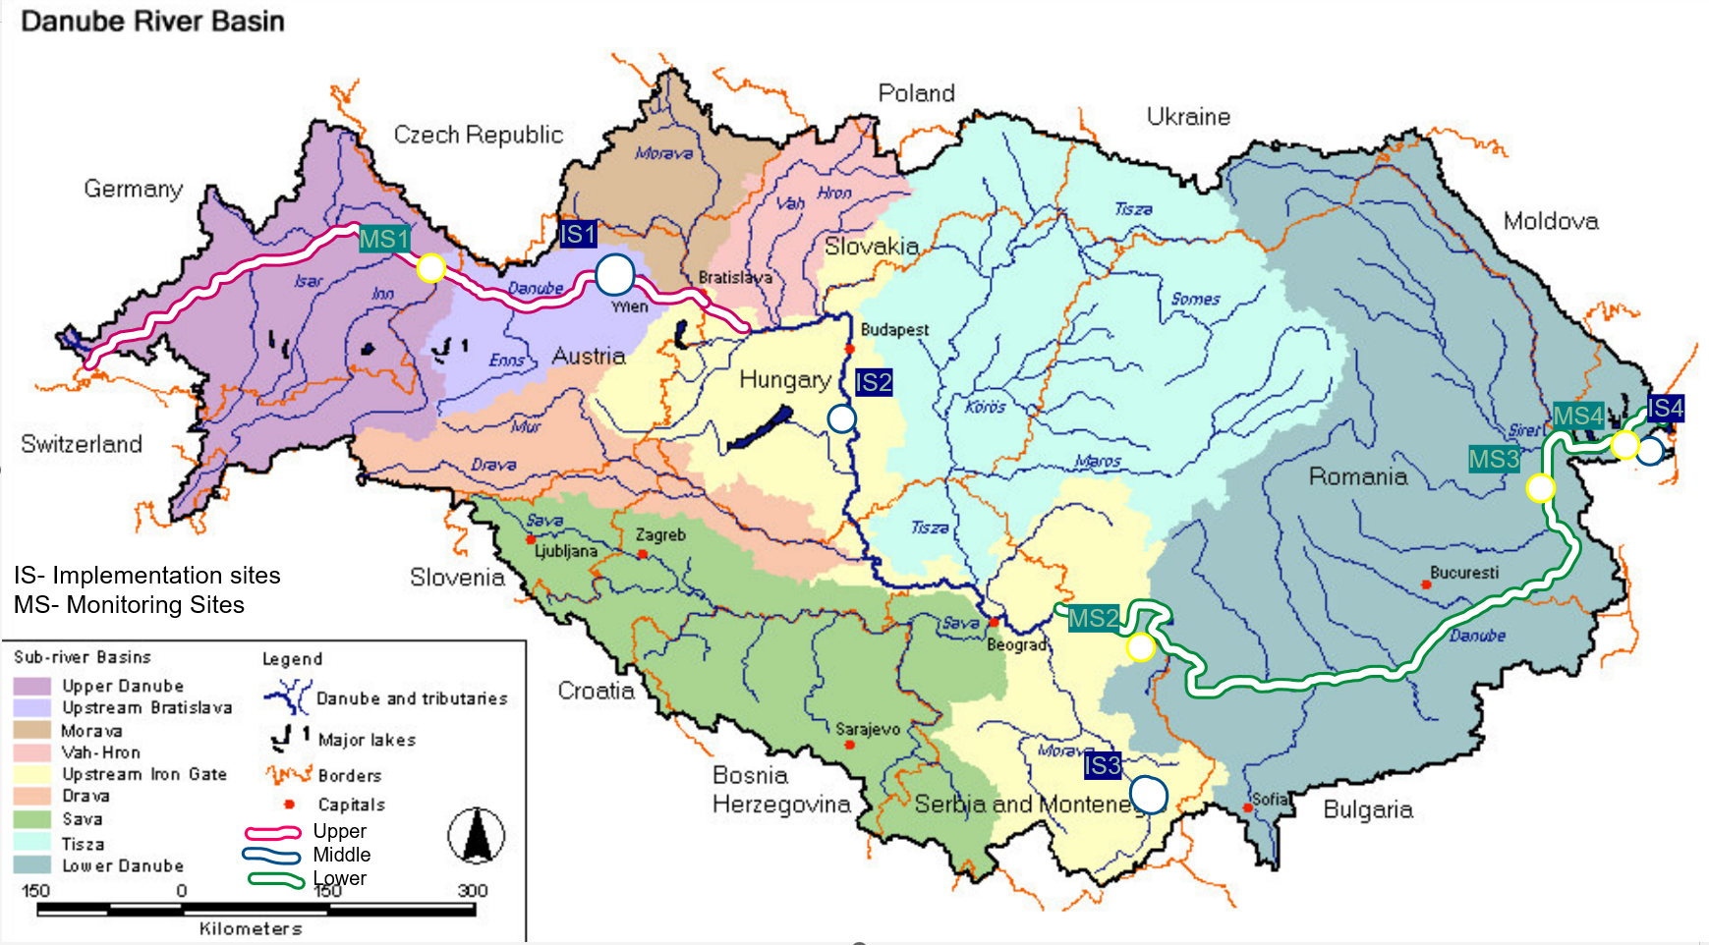
Implementation and monitoring sites
4 Implementation sites
6 Monitoring sites
IS1 – March Thaya, AT/SK
IS2 – Rudava, SK
IS3 – Vlasina, SRB
IS4 – Enisala, RO
MS1 – Lower Salzch, AT/SK (BOKU, IGB)
MS2 – Dunajske, SK (ILE SAS, Broz)
MS3 –Gornje Podunavlje, SRB (UNSPMF, FSM, UNIOS)
MS4 –Danube Delta Coast, RO (Geoecomar, INCDD)
MS5 – Braila Island, RO (UB, WWf, UGAL)
MS6 – Danube Delta Carasuhat, RO (INCDD, WWF, Geoecomar, UGAL)

Slide 13
Four Implementation Sites Across the Danube Basin
IS1
Austria
Combined Impact
March-Thaya Floodplains
20000 ha
IS2
Slovakia
Wetland Area
Rudava River
50+ km
IS3
Serbia
Vlasina Reservoir
River Length
IS4
Romania
Enisala Wetlands

Slide 14
Restoration Approaches
Combining passive and active measures for sustainable outcomes
Passive Restoration
Active Restoration
"Let nature heal itself"
"Engineer the recovery"
Removing barriers
• Rip-rap removal (IS1)
• Channel obstructions (IS2)
Reconnection
• Natural riverbed restoration
• Hydrological dynamics
Invasive species control
• Non-chemical methods
• Mechanical harvesting
Infrastructure
• Channel dredging (IS4)
• Culvert construction (IS3)
Planting
• Native species reintroduction
• Riparian buffer zones
Water management
• Weirs and flow control
• Sediment traps

Slide 15
IS1: March-Thaya Floodplains, Austria
Site Characteristics
Implementation Status
Location: March River near Hohenau
Protection: Natura 2000, Ramsar Site
Bank restoration: 835m (R4L) + 6.7km extended
Side-arm reconnection: ~6.3 km
Floodplain affected: ~3 km² (8 km² with ReConnect)
✓ All permits finalized
✓ Landowner agreements secured
✓ Cross-border coordination (SK)
→ Construction: Spring 2026
→ Completion: Summer 2026
Restoration Measures
Expected Outcomes
• Removal of rip-rap (bank boulders)
• Enable bank-forming processes
• Woody debris as flow barriers
• Willow planting for softwood forest
• Meander reconnection (cross-border)
• Sandy habitats for Odonata species
• Improved flood protection
• Enhanced water retention
• Habitats for weatherfish (Misgurnus)
• Catalyst for large-scale restoration

Slide 16
IS2: Rudava River, Slovakia
The Challenge
Technical Documentation
60-70 years ago, the entire Rudava River discharge was redirected into an artificial channel, leaving the natural meandering riverbed completely dry.
• 6 restoration scenarios (A-F)
• 7 intervention locations identified
• 2D hydrological model developed
• Frame culverts with sluice gates
• Discharge regulation capability
River section: rkm 25-31
River length to restore: ~6,000 m
Floodplain affected: ~560 ha
Protection: Natura 2000, Ramsar
Pre-monitoring (2025)
• High-resolution satellite imagery (SPOT6)
• Groundwater probe network
• Soil moisture sensors (10cm, 50cm)
• Biotic monitoring: fish, birds, insects
• Passive acoustic bird monitoring
Restoration Approach
• Redirect water to natural riverbed
• Remove local barriers
• Restore hydrological dynamics
• Improve fish migration

Slide 17
IS3: Vlasina Wetlands, Serbia
Focus: Restoring transitional mires (acidic fens) - EUNIS D2.226 Peri-Danubian black-white-star sedge fens
Passive Measures
Active Measures
Tree species removal from fen areas
• Removed Betula pendula, Populus tremula
• Preserved protected species (B. pubescens)
• ~6.5 ha cleared so far
Invasive species control (Elodea nuttallii)
• Non-chemical methods only
• Selective & non-selective harvesting
• Jute matting for shading
River meander restoration
• Redirected intermittent streams
• 500m of meanders restored in 2025
Afforestation of buffer zones
• ~100 native willows planted
• Salix alba, Salix cinerea
Riparian planting
• Carex, Equisetum, Filipendula species
Carbon Stock: ~2,533 tC over 11.7 ha | Soil carbon pool: 180-190 tC/ha | Total: ~216 tC/ha average

Slide 18
IS4: Enisala Wetlands, Romania
2,370 hectares
Technical Solution
Largest implementation site in Restore4Life
Channel re-profiling: 3.25 km
• Northern channel: 428.9m × 8m × 2m
• Internal channel: 2,795m × 6m × 1.5m
Sediment volumes:
• 5,146 m³ (reconnection)
• 30,301 m³ total excavation
Small lakes revitalization: 25-35 ha
Restoration Objectives
• Improve water circulation
• Reconnect secondary channels to Lake Razim
• Reduce eutrophication through reed bioremediation
• Create sediment trap zones
• Restore fish spawning habitats
Expected Benefits
Ecological: Reed absorbs 20-30 kg N/ha • Natural water filtration • Fish habitat restoration
Socio-economic: 10 km tourist route • Traditional fishing revival • Connection to Enisala Fortress heritage

Slide 19
Integrated Monitoring Framework
Earth Observation
In-Situ Monitoring
Citizen Science
• High-res satellite imagery (SPOT6)
• UAV/drone surveys
• LIDAR for terrain models
• NDMI moisture indices
• Carbon stock mapping
• Water quality sensors
• Groundwater probes
• Soil moisture sensors
• Biotic surveys (fish, birds)
• Acoustic monitoring
• Community data collection
• Peat sampling protocols
• Species observation
• Validation of remote data
• Local knowledge integration
Machine Learning Applications (IS4 Romania)
• AutoML for water quality prediction | Random Forest & XGBoost (R² = 0.87-0.99) | WQI soft sensors reduce monitoring costs

Slide 20
Stakeholder Engagement
Building communities of practice for sustainable restoration
Government & Authorities
Ministries, Water Management, Biosphere Reserves, Municipalities
Research & Academia
Universities, Research Institutes, SAS, BOKU, UFZ
Land & Resource Managers
Forestry, Fisheries, Agriculture, Military Forests
Civil Society & NGOs
WWF, Environmental NGOs, Local associations
Private Sector
Tourism operators, Dredging companies, Agribusiness

Slide 21
Key Lessons Learned
1
Cross-border collaboration is essential
Austria-Slovakia coordination enabled meander reconnection across borders
2
Land ownership complexity requires patience
delayed due to complex ownership; early stakeholder mapping critical
3
Flexible approaches handle procurement challenges
adapted when tenders failed; in-house expertise provided solutions
4
Participatory planning builds support
roundtables with fishermen and tourism created shared ownership
5
Monitoring must precede intervention
Baseline data essential; pre-monitoring in all sites before works begin

Slide 22
The Restore4Life Platform
Danube Basin Knowledge Hub for Wetland Restoration
Data Repository
Best Practices Library
Centralized monitoring data, satellite imagery, and field measurements from all sites
Documented restoration approaches, lessons learned, and replicable methodologies
Stakeholder Network
Decision Support Tools
Connected community across 31 partners and 12 countries for knowledge exchange
Hydrological models, carbon calculators, and ML-based monitoring tools
platform.restore4life.eu

Slide 23
Let’s see the
DANUBE RESTORATION HUB!

Slide 24
Looking Forward: 2026 and Beyond
2027- 2300!
• Scalable restoration models for the entire Danube Basin
• Web platform – Danube Restoration HUB (Knowledge platform as permanent resource for practitioners)
• Integrated monitoring protocols adopted by national agencies
• Cross-border cooperation frameworks for transnational ecosystems
• Contribution to EU Nature Restoration Law targets

Slide 25
Thank you!

